Slide 1

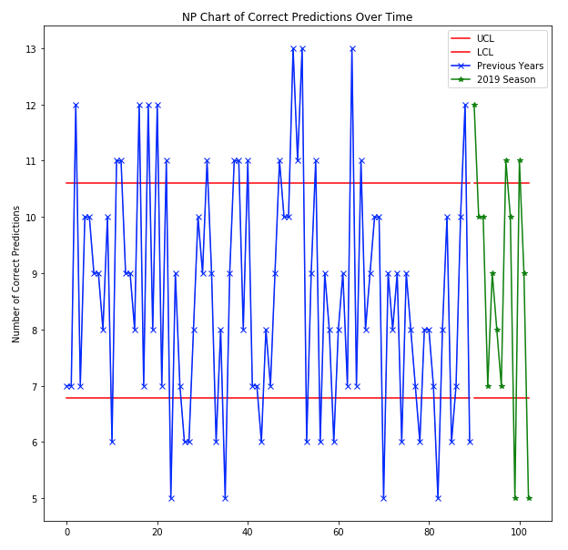
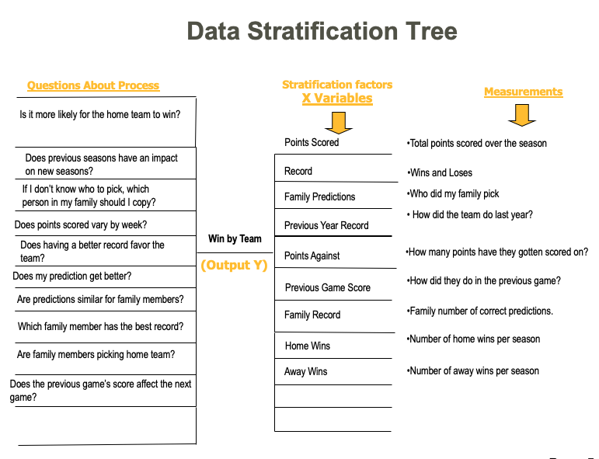

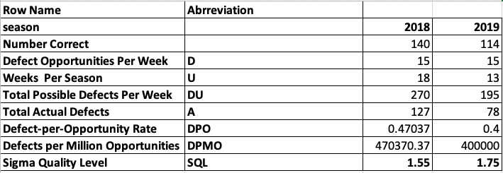
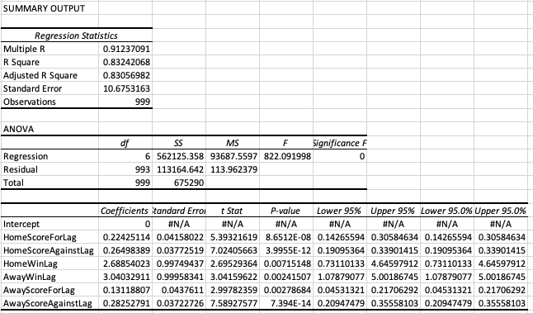
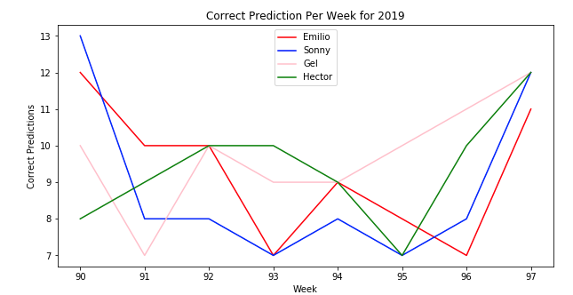
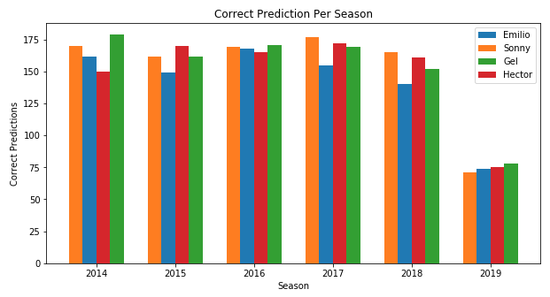
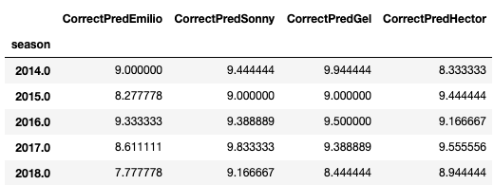
NFL Game Prediction
Process owner: Emilio Ramos Monzalvo
Key Dates --->
Team
Launch
Define
9/12/2019
Measure
2014-2019 season
Analyze
9/19/2019
Improve
9/26/2019
Control
11/28/2019
DEFINE
MEASURE
ANALYZE
IMPROVE
Chi-Squared Test of Independence:
Predictions became more random during my improvement face as they seem to be going out of bounce more often now.
Every year my family and I have been playing a game where we try to predict the winner of each NFL game.
At the end of the season, we count all the correct predictions and whoever has the most wins.
I have never won before and it is about time for that to change.
In the past 5 seasons, the closest I have been from winning is 3 points, so getting one more correct prediction per week can lead me to win.
The chi-square statistic is 46.5237. The p-value is < .00001. The result is significant at p < .05.
--> Winning is not independent from whether the team is playing home or away, so picking the home team is a better choice.
* Dad has been collecting data for the past 6 seasons.
SQL improved from 1.55 to 1.75 in the 2019 season!
Last Season is still in progress.
CONTROL
Using the p-value form the multiple regression, I was able to get the most important factors int the amount of points scored in a game by a team.
-> The most important factor turned out to be the amount of points scored against the opposition in the previous game.
Keep track of the scores of the previous games
The amount of points scored on the teams is seen to have the most impact on the score of the team.
When not knowing which team to pick, do not pay attention to who is playing home and away.
I will continue to check the NP-chart to see if there is any change in the time series.
* Number of wins is Discrete.
The winner has won by a very small margin in the past 5 years. Even a couple more correct prediction might give me the crown.
* My mean correct prediction has been low for the past 5 years and it does not show any improvement.

Slide 2
Define
Inputs (Get the data for away and home team):
Previous Points Scored
Previous Points Against
Home Wins
Away Wins
Previous Season Scores
Home or Away Game
My Prediction in Last Game
For the past 10 years, my family (Mom, dad, brother and I) has been trying to predict the winner of each NFL game. Each week, we pick who we think the winner will be, and then we get the results back from my dad who has been keeping track of this in excel files.
At the end of the season, we count up how many correct predictions we each had and the one with the most correct prediction gets bragging rights for the whole year.
I have never been able to win the season and I am hoping that statistics will be able to help me win my first season.
Output:
Who Will Win the Game?

Slide 3
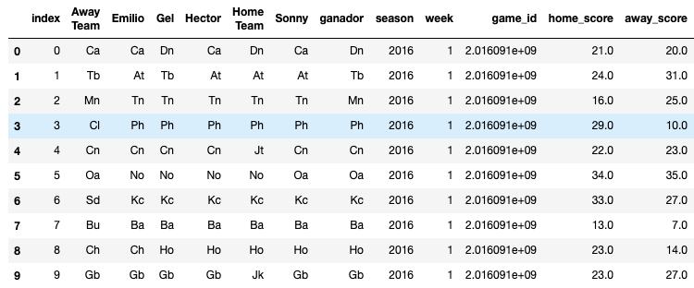
Measure
Dad has been collecting my predictions and my family’s over the last 5 years.
The predictions only consists of who won the game and who each family member predicted to win.
I had to pull the data from https://github.com/ryurko/nflscrapR-data to get the results corresponding to each game and merge it to my dad’s data.
The data is DISCRETE since we are counting the number of correct predictions.
Ex:
The data from the web and the data from my dad contain different abbreviations for the teams, so there might be some errors in the merging of the data.
Also the data was inputted manually into excel, so there might be a couple of errors in the data.

Slide 4
Data Stratification Tree
Questions About Process
Stratification factors
X Variables
Measurements
Is it more likely for the home team to win?
Points Scored
Total points scored over the season
Does previous seasons have an impact on new seasons?
Record
Wins and Loses
If I don’t know who to pick, which person in my family should I copy?
Family Predictions
Who did my family pick
How did the team do last year?
Does points scored vary by week?
Previous Year Record
Does having a better record favor the team?
Win by Team
Points Against
How many points have they gotten scored on?
(Output Y)
Does my prediction get better?
How did they do in the previous game?
Previous Game Score
Are predictions similar for family members?
Family Record
Family number of correct predictions.
Which family member has the best record?
Home Wins
Number of home wins per season
Are family members picking home team?
Away Wins
Number of away wins per season
Does the previous game’s score affect the next game?
Page 5

Slide 5
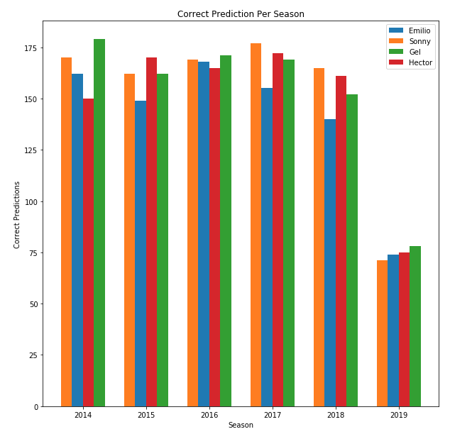
Analyze
Bar Graph:
The Bar Graph shows how tight the seasons are. Some season are even won by two or three points. Therefore, even having one or two better predictions per week can have a huge impact.
Last Season is still in progress.

Slide 6
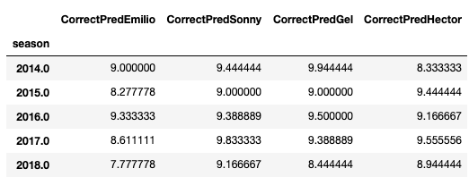
Analyze
Average Correct Predictions Per Week For Each Season:
The average correct predictions per week can tell us how good we are doing, and how well need to be doing in order to win. Here we see that the winner is averaging more than 9.444 in 3 seasons. Therefore, I need to be predicting correctly about 10 games per week.
My last season’s average is around 7.78 games per week which is very low compared to what it should be.

Slide 7
Analyze
Chi-Squared Hypothesis Test
With the Chi-Squared Test for independence, we can deduce if winning is dependent on whether the team wins or loses.
Since the p-value we got is less than .05, then we can reject the null hypothesis. Therefore we are at least 95% confident that a team winning is not independent of the games location.
I moved forward assuming that the home team is more likely to win.
Ho: Winning is independent laying home or away.
Ha: Winning is not independent playing home or away.
Significance Values = .05
The chi-square statistic = 46.5237.
The p-value is < .00001.
The result is significant at p < .05.

Slide 8
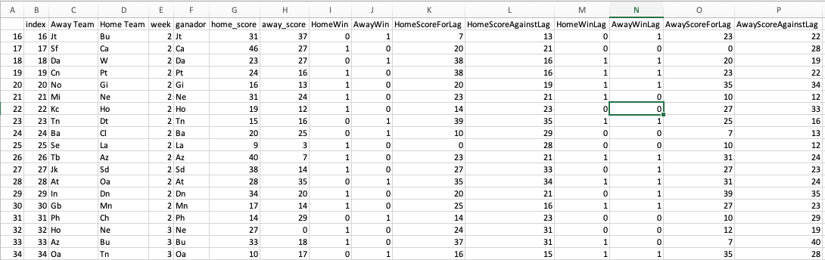
Analyze
Inputs:
Home Score For In Last Game
Home Score Against In Last Game
Away Score For In Last Game
Away Score Against In Last Game
Home Win Last Game
Home Loss Last Game
Output:
* How many points will the home team score?
In the results we see that the score against the away team in the previous game is the biggest contributor to the home teams’ score on the next game.
We can use these results to figure out how many points the home team will score, and see if they are sufficient to beat the away team.

Slide 9
Analyze
NP-Chart of Number of Correct Predictions:
The NP-Chart was calculated using my predictions for the past 5 years which is plotted in blue. Then, the green represents my current predictions in the 2019 season.
One can see that the predictions became more volatile once I applied my knowledge I got from my analysis.

Slide 10
Analyze
Sigma Quality Level
The main purpose of using SQL is to check whether the sigma quality level of my predictions is getting better or worse in the 2019 season.
The defect opportunities was set to the number of games per week which is almost always around 15 games. Then, the units are the number of games and the day is the week.
From the results, we can conclude that so far during the 2019 season the sigma quality level has improved compared to the 2018 season.

Slide 11
Improve
Solutions:
From the analysis we can up with two solutions in order to figure out which team to pick:
Pick the team who got scored on the least amount of points in the previous week.
The home field advantage does not seem to yield much impact on who wins.
It is better to check the results of the previous games.
Improvement:
By looking at the SQL values for the 2018 and the 2019 season we can conclude that the adjustments previously mentioned are working.
On the other hand, the NP-Chart does not show any significant change in the number of correct predictions per week, but it does look more volatile.
All in all, I am currently in second place so I am satisfied with the results so far even if there is room for improvement.

Slide 12
Control
In order to keep improving my prediction, I plan on doing the following:
Keep track of the previous games played:
Number of wins.
Number of points scored on.
Keep checking on the NP-Chart in order to see if there is a significant change on my number of predictions per week.
Recalculate SQL at the end of the season in order to see if the 2019 season did show a significant improvement.

